Slide 1
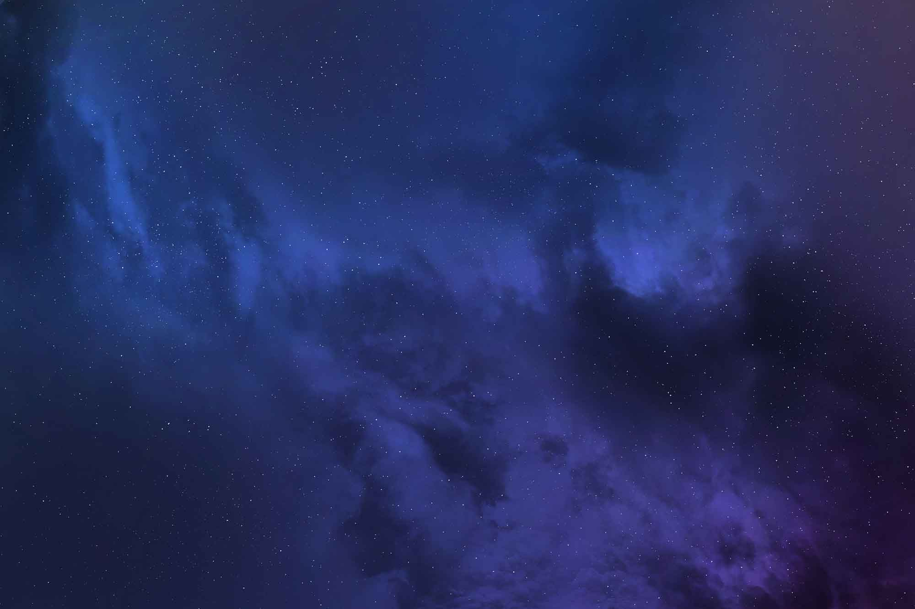
Nasa Space Apps Challenge 2023
Team name: PAPEIravloi

Slide 2


Meet the team!
Panagiotis Markos Klonis
Panagiotis Tsagkouris
Dimitris Martinos
Irini Loli
Orestis Karapiperis
Nickolas Raptis

Slide 3
The Challenge:
Eclipses: Perspective is Everything

Slide 4


Objective
Our objective is to explain the mechanics of eclipses, answering questions such as:
What is an eclipse ?
How do they occur?
Why do only some people on Earth see an eclipse at a given time?
What causes the Sun, Moon, and Earth to align?
How often do they occur?
How do scientists know when and where eclipses will occur?
What is the difference between a lunar and solar eclipse?
What is an eclipse season and why do they occur approximately every six months (or twice a year)?

Slide 5
Eclipses Demystified
We chose to answer the above questions by creating an interactive web application that provides straightforward explanations and engaging visuals to make complex concepts accessible to all, beginners and seasoned enthusiasts!

Slide 6
Interactive Learning
We explore beyond static content by offering interactive learning experiences.
Users can engage with simulations and interactive tools that allow them to visualize the processes behind eclipses and grasp these concepts intuitively.

Slide 7
Impact
Accessible Education
Filling a Knowledge Gap
Inspiring the Next Generation
Global Reach

Slide 8

Explore our website!
You can visit our website here:
https://papeiravloi-nasa-eclipses.netlify.app/src/eclipse_app.html

Slide 9
Questions??

Slide 10
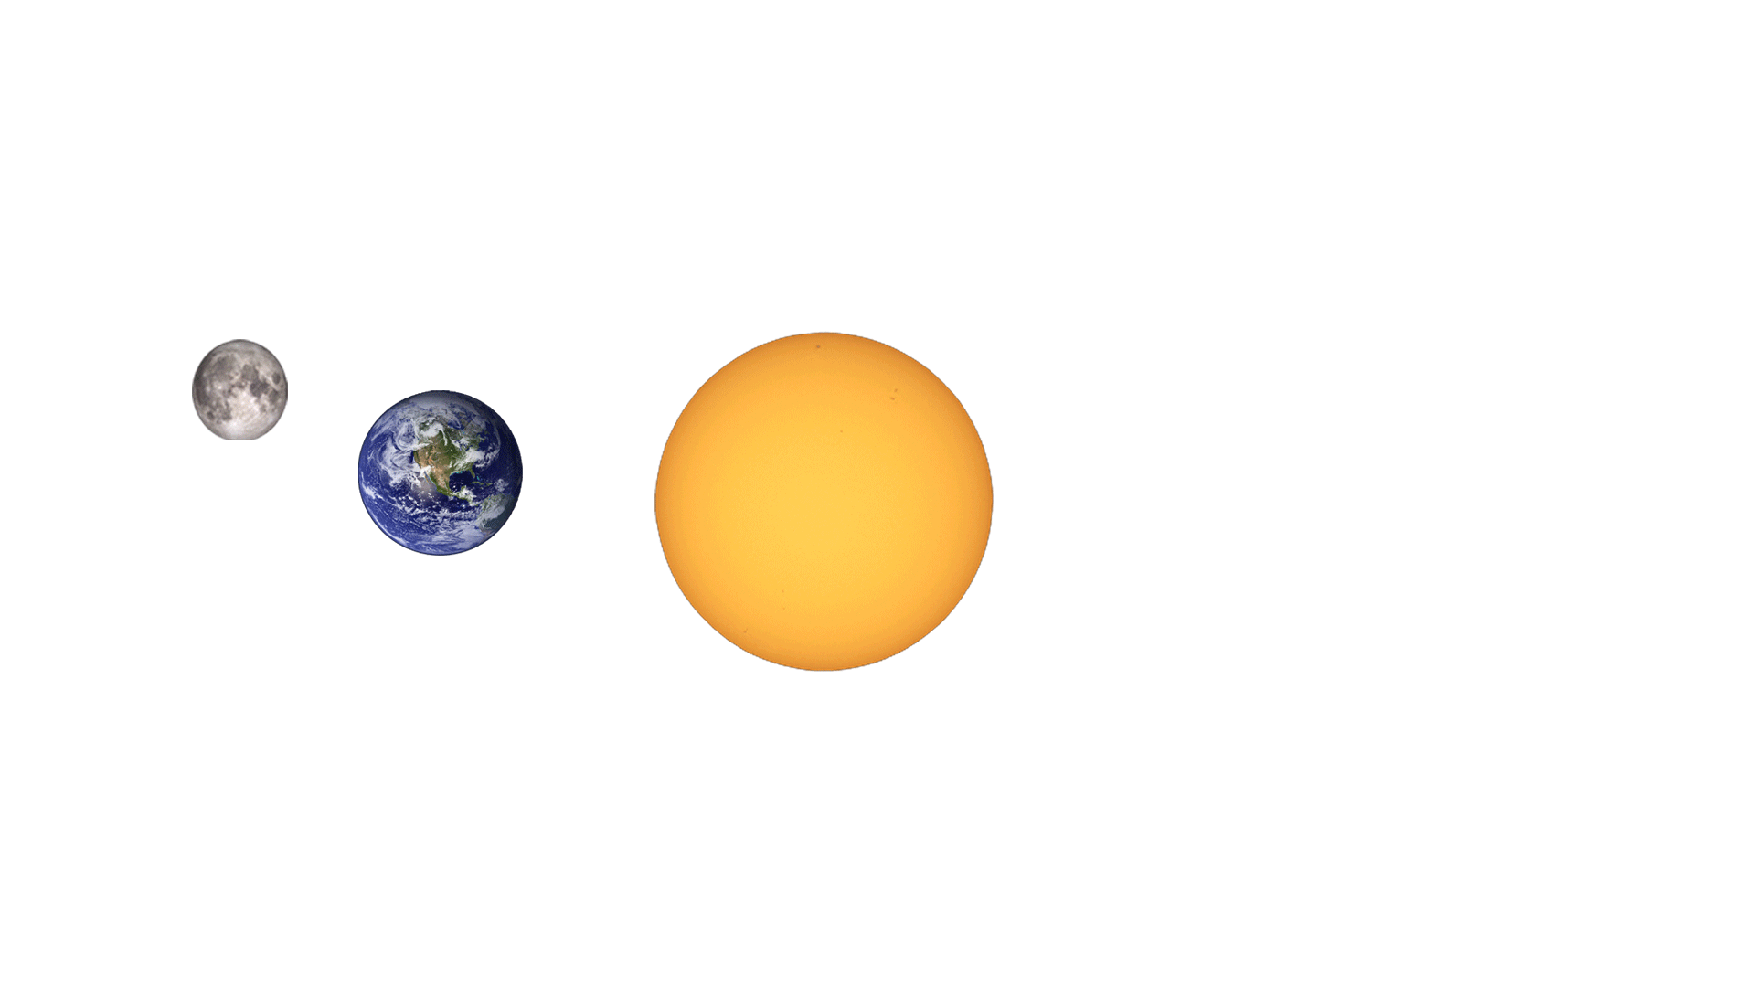
Thank you for your time!!

